Slide 1
Recycling
Environmental and Societal Considerations
Energy consumption
  Cost of production
Pollution
  Littering and environmental preservation
Health
  Control of toxic materials [hazardous waste]

Slide 2
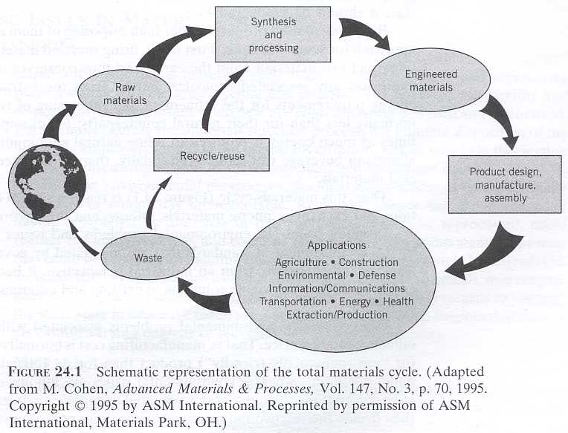
Recycling – [Callister Ch. 21]
Materials Cycle
Raw materials
Synthesis
  Engineered materials
Product design
Applications
Waste
  Recycle / reuse
  Waste collection
  Litter!!!!!

Slide 3
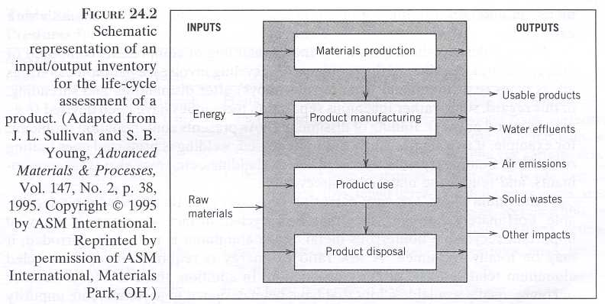
Recycling – [Callister Ch. 24]
Life Cycle Assessment of a Product

Slide 4
Recycling – [Callister Ch. 24]
What Products are Recycled?
Metals
  Lead (Pb) – e.g., lead batteries
  Aluminum (Al) – e.g., aluminum cans
  Iron/steel (scrap metals)
  Gold, silver, platinum (e.g., contacts in electronic devices)
Rubber and plastics
  PET and polycarbonates – e.g., plastic bottles
  Tires
  Textile fibers
Glass
  Bottles
Paper
  Newspapers, cardboard boxes, etc.

Slide 5
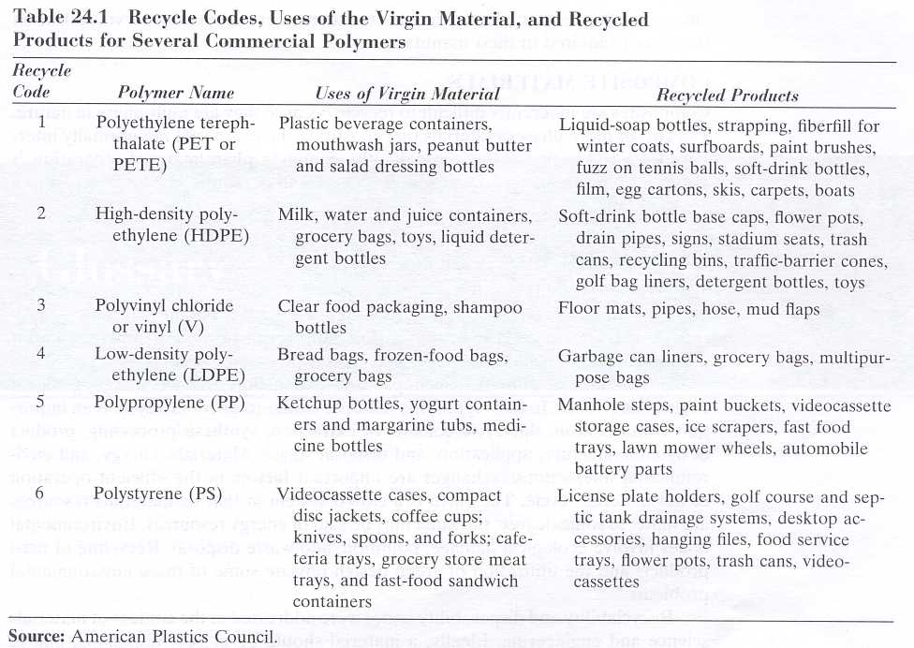
Recycling – [Callister Ch. 24]
Polymer recycling codes

Slide 6
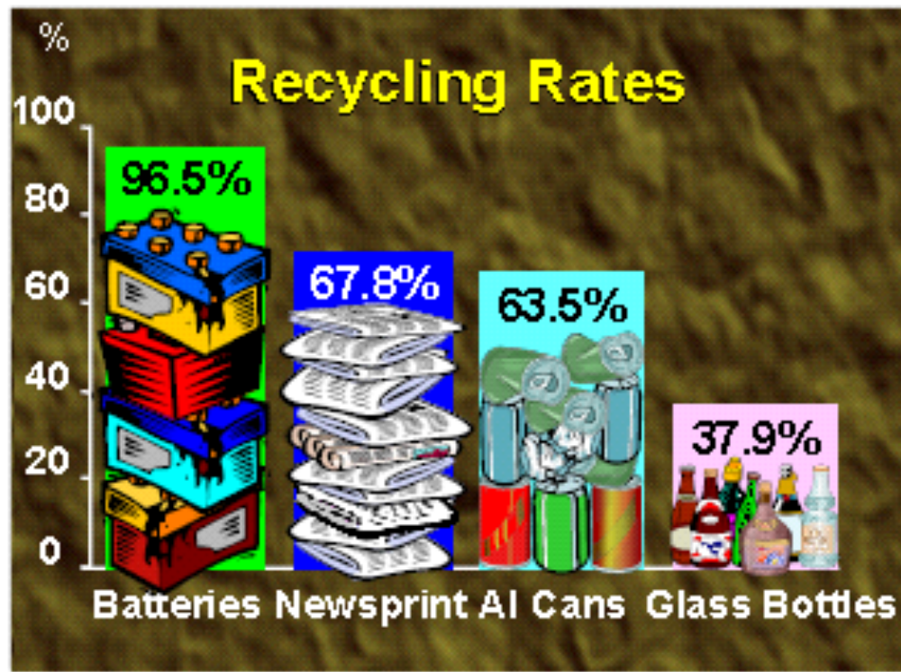
Recycling – [Callister Ch. 21]
Ref: http://www.icmm.com/gmi_conference/ 433BrianWilsonPresentation.pdf

Slide 7
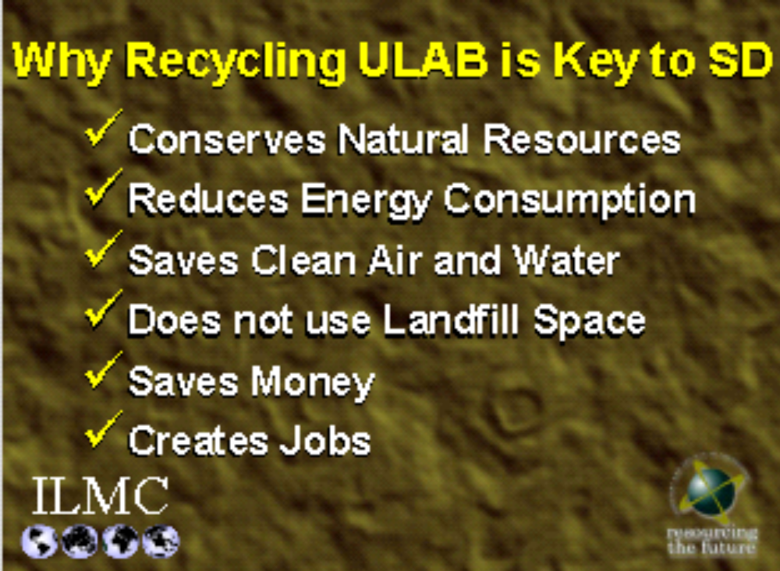
Recycling – [Callister Ch. 24]
ULAB: used lead acid batteries
Ref: http://www.icmm.com/gmi_conference/ 433BrianWilsonPresentation.pdf

Slide 8
Glass recycling
Benefits:
  Saves energy (and time) during melting — major mfg. cost
    Pre-melted glass is
      Pre-reacted
      (SiO₂ + NaCO₃ + CaCO₃ ⇒ window or container glass)
      Pre-homogenized
      “Fined” (i.e. rid of bubbles)
  Reduces demand on raw materials
  Reduces need for landfill
Sources of recycled glass (a.k.a. “cullet”):
  In-plant: scrap, breakage — has been used for decades
  Post-consumer: collected from recycling centers

Slide 9
Recycling – [Callister Ch. 21]
Aluminum Cans
Used aluminum beverage container (UBC) trends in the United States
Aluminum beverage can sales have been steady at roughly 100 billion cans/year
UBC recycling rate is declining
UBC waste is increasing
(in billion units & total tonnage)
True for glass and plastics as well.
Ref: http://www.container-recycling.org/assets/ppt/GitlitzEPAOct29-02.ppt.

Slide 10
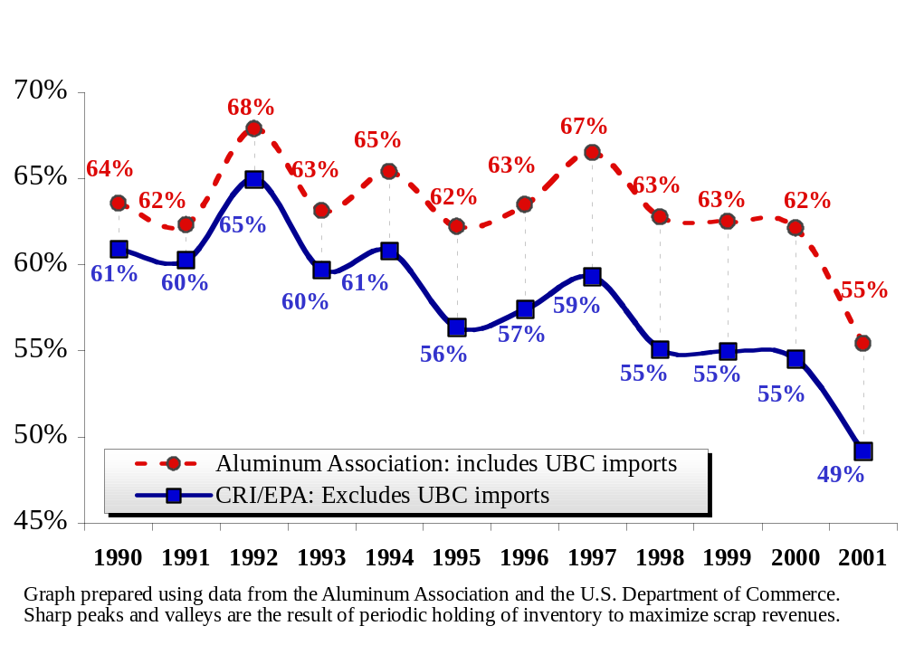
Recycling – [Callister Ch. 21]
Aluminum Can Recycling Rates
Ref: http://www.container-recycling.org/assets/ppt/GitlitzEPAOct29-02.ppt.

Slide 11
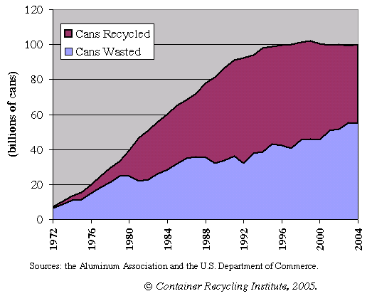
Recycling – [Callister Ch. 21]
Aluminum Cans Wasted
Ref: http://www.container-recycling.org/

Slide 12
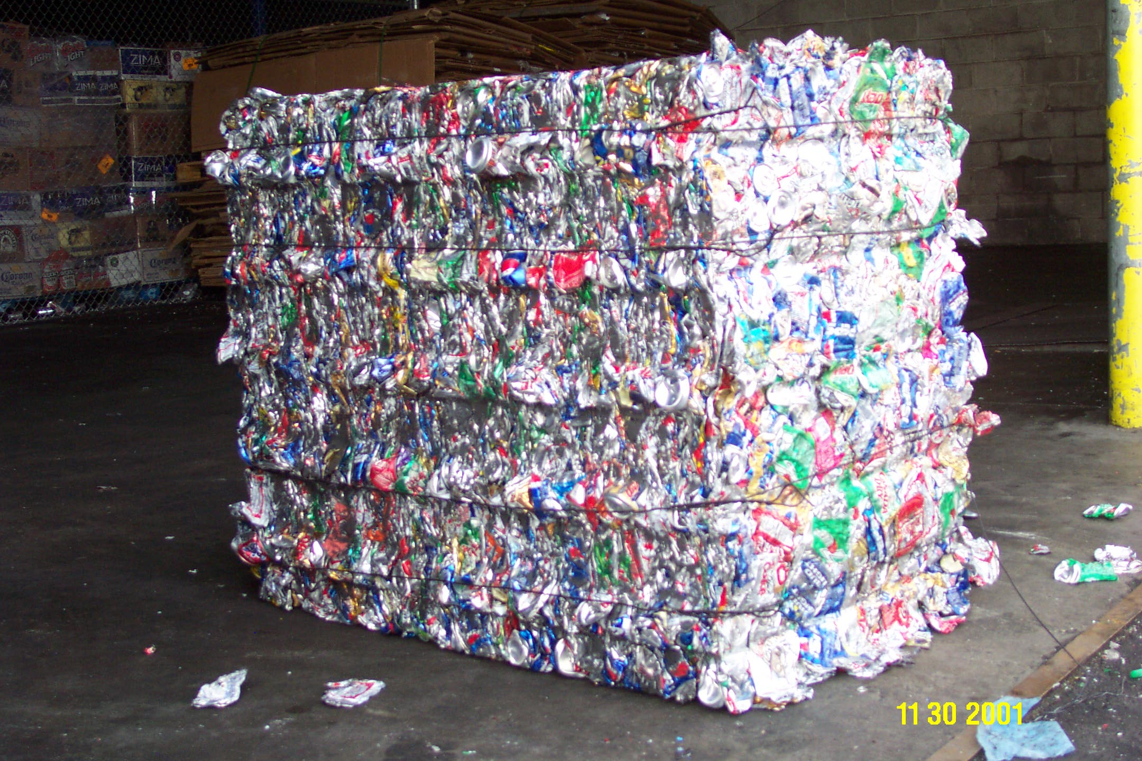
Recycling – [Callister Ch. 21]
Aluminum – A Squandered Metal
Two million of these 700-pound bales could have been made from the aluminum cans wasted in the U.S. last year.
Ref: http://www.container-recycling.org/assets/ppt/GitlitzEPAOct29-02.ppt.

Slide 13

Recycling – [Callister Ch. 21]
Aluminum – A Squandered Metal
Between 1990 and 2000, Americans wasted a total of 7.1 million tons of cans: enough to manufacture 316,000 Boeing 737 airplanes—or enough to reproduce the world’s entire commercial airfleet 25 times.*
  * Based on aluminum can wasting from 1990-2000 (7.1 million tons), 16,000 jets in the worldwide commercial fleet, and an average of 35,000 lbs of aluminum per plane.
Ref: http://www.container-recycling.org/assets/ppt/GitlitzEPAOct29-02.ppt.

Slide 14

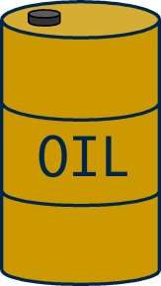
Recycling – [Callister Ch. 21]
Wasting aluminum cans has disproportionate environmental impacts
Aluminum cans are only about 1.4% of a ton of Municipal Solid Waste (MSW) by weight, but they account for 14.1% of the greenhouse gas impacts of replacing a ton of landfilled garbage with new products made from virgin materials.
☑
Total greenhouse gas emissions from replacing the 50.7 billion cans wasted in 2001: 3.1 million MTCE.
Wasted energy: The energy required to replace the 50.7 billion cans wasted in 2001 was equivalent to 16 million barrels of oil: enough to keep 1.3 million American cars on the road for a year.
Ref: http://www.container-recycling.org/assets/ppt/GitlitzEPAOct29-02.ppt.

Slide 15

Recycling – [Callister Ch. 21]
Bauxite ore: 4-5 tons are needed to make 1 ton of primary aluminum
A red mud lake in Jamaica. Dust from alumina refining and export operations has caused respiratory and aesthetic damage, and portside alumina spills have harmed coastal coral reefs. In 2000, the U.S. imported 3 million tons of bauxite and 400,000 tons of alumina from Jamaica, over 90% of which was used for primary aluminum.
Photo: Dr. Robert J. Lancashire, University of the West Indies.
Ref: http://www.container-recycling.org/assets/ppt/GitlitzEPAOct29-02.ppt.

Slide 16

Recycling – [Callister Ch. 21]
Pollutants from “replacement production” of
759,625 tons of cans wasted in 2001
55,613 tons of SOx
19,476 tons of NOx
}
Acid rain and smog
}
5.5 million tons of CO₂
84,532 tons of CO
1,025 tons total fluorides
Greenhouse gases
15,828 tons of PM ⇨ respiratory distress
}
482 tons of VOC’s (Volatile Organic Compounds)
2,776 tons of organics
Carcinogens
2.7 million tons of toxic mud wastes and other residues
Ref: http://www.container-recycling.org/assets/ppt/GitlitzEPAOct29-02.ppt.

Slide 17
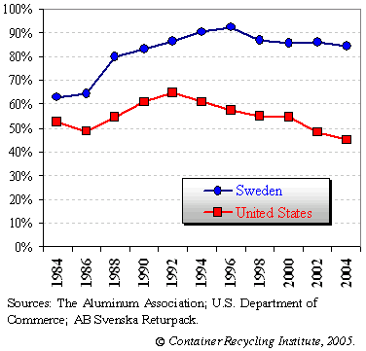
Recycling – [Callister Ch. 21]
Recycling rates for aluminum cans
in Sweden and the U.S. (1984-2004)
WHY?

Slide 18
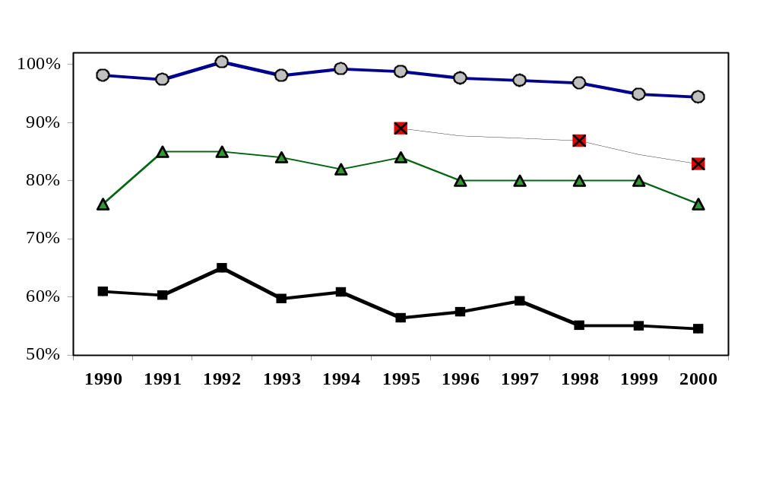
Recycling – [Callister Ch. 21]
Financial incentives are key to attain beverage container recovery rates of 80% or more
Michigan (b): 10¢ deposit
Oregon (a): 5¢ deposit
California (a): 2.5¢ and 5¢ deposits
U.S. average (a)
(a) Recycling rate for aluminum only (container types reported separately.)
(b) Redemption of plastic, glass and aluminum containers not reported separately. Actual state recycling rates for aluminum are probably higher than those indicated here, because in some states, cans are considered unredeemed (or "abandoned") even when they are recycled through curbside programs or by commercial haulers, and because some non-carbonated beverages in aluminum cans are also being recycled for their scrap value. See endnote 66 for sources.
Ref: http://www.container-recycling.org/assets/ppt/GitlitzEPAOct29-02.ppt.

Slide 19
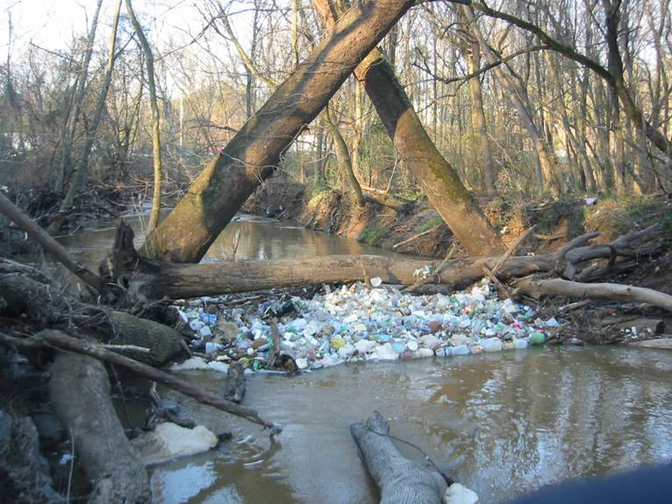
Recycling – [Callister Ch. 21]
PET - Plastic Debris – Rivers to Sea
Ref: http://www.container-recycling.org/ assets/ppt/1PlasticDebrisConference9.ppt

Slide 20
Recycling – [Callister Ch. 21]
PETE
There were no plastic beverage bottles in the 1930’s, 40’s, 50’s, 60’s, and very few in the 1970’s and 80’s.
In 2006 Americans will drain more than 50 billion single-serving PETE plastic beverage bottles . . . an estimated 40 billion will end up landfilled or littered.
The thermoplastic nature of PETE (and HDPE, LDPE, PS, PVC, PP …) makes them inherently suitable for remelting and recycling.
Ref: http://www.container-recycling.org/ assets/ppt/1PlasticDebrisConference9.ppt

Slide 21
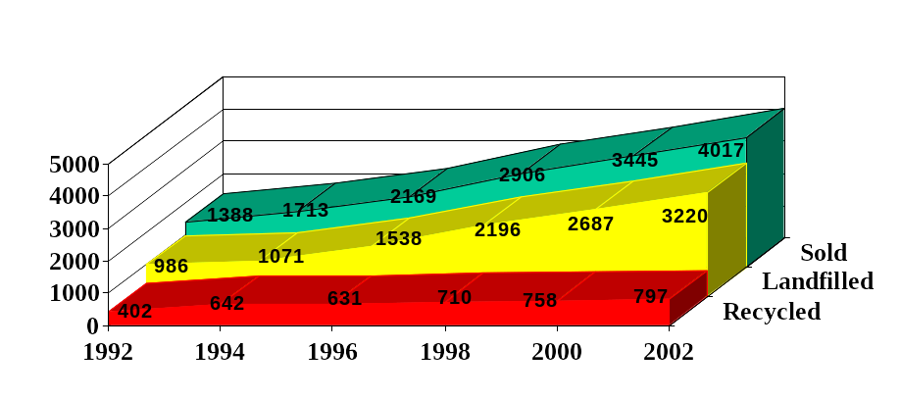
Recycling – [Callister Ch. 21]
PET Bottle Growth Strong….
PET Bottle Recycling Stagnant
Mm lbs
Source: “2002 National Post-Consumer Plastics Recycling Report.” R.W. Beck, Inc. for the American Plastics Council. 2003.
Ref: http://www.container-recycling.org/no anima APR Prez2-18-04 FINAL.ppt

Slide 22
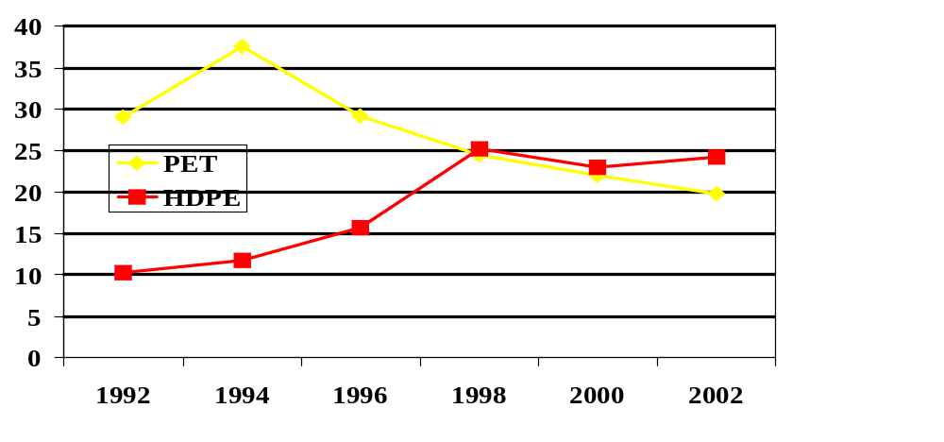
Recycling – [Callister Ch. 21]
Recycling Rates: PET and HDPE
Percent
38%
24%
20%
12%
Source: “2002 National Post-Consumer Plastics Recycling Report.” R.W. Beck, Inc. for the American Plastics Council. 2003.
Ref: http://www.container-recycling.org/no anima APR Prez2-18-04 FINAL.ppt

Slide 23
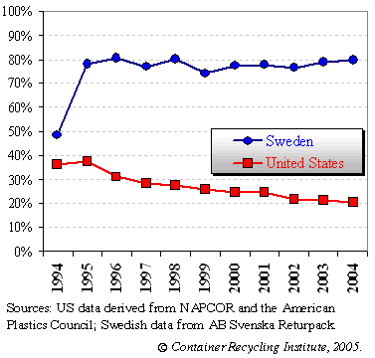
Recycling – [Callister Ch. 21]
Recycling rates for plastic bottles in Sweden and the U.S. (1984-2004)
Economic incentives

Slide 24
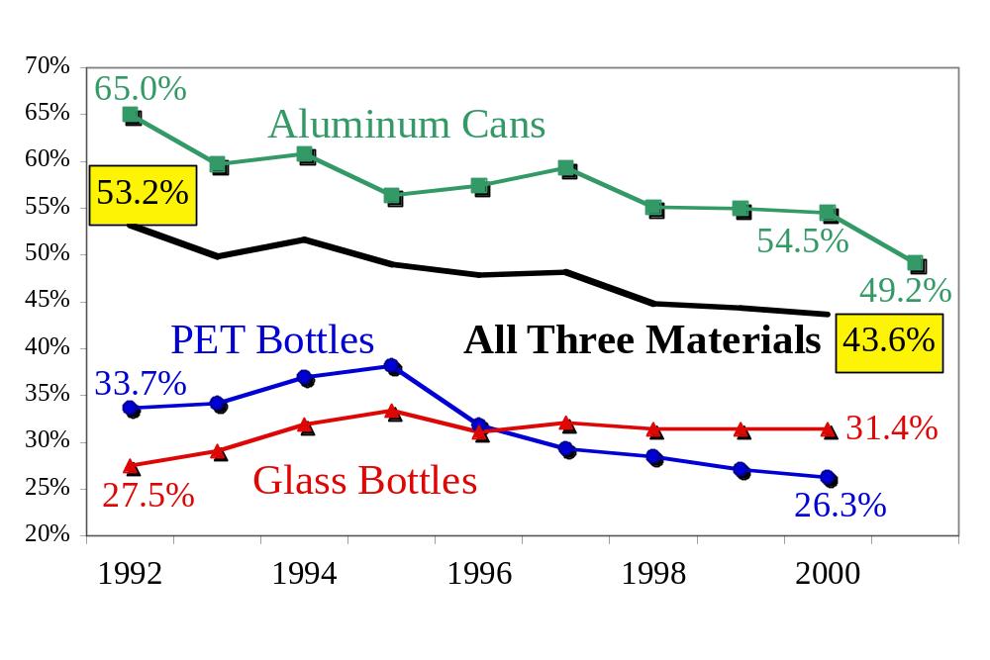
Recycling – [Callister Ch. 21]
Recycling of Beverage Containers
Voluntary Systems Inadequate
Ref: http://www.container-recycling.org/no anima APR Prez2-18-04 FINAL.ppt

Slide 25
Recycling of curbside bottles
Mixed bottle bales are opened
Manual removal of debris and obvious PVC bottles*
Bottles are shredded into ~ 1 cm squares
Washed with hot soapy water
Rinsed with water
Float/sink separation of polyolefins from polyester
olefins are dried, sold for plastic lumber, other applications
Polyesters is dried, sold for fiber, strapping, other applications
* PVC and PET have ~ same density (1.35 g/cc)
PE and PP have ~ same density (0.9 g/cc)
Ref: http://www.container-recycling.org/no anima APR Prez2-18-04 FINAL.ppt

Slide 26
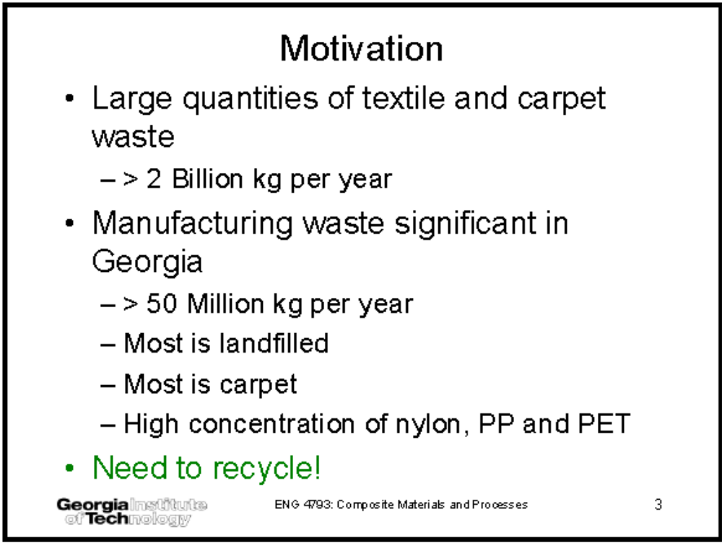
Recycling – [Callister Ch. 21]
Textile Fibers - Thermoplastics
Ref: http://www.ce.gatech.edu/

Slide 27
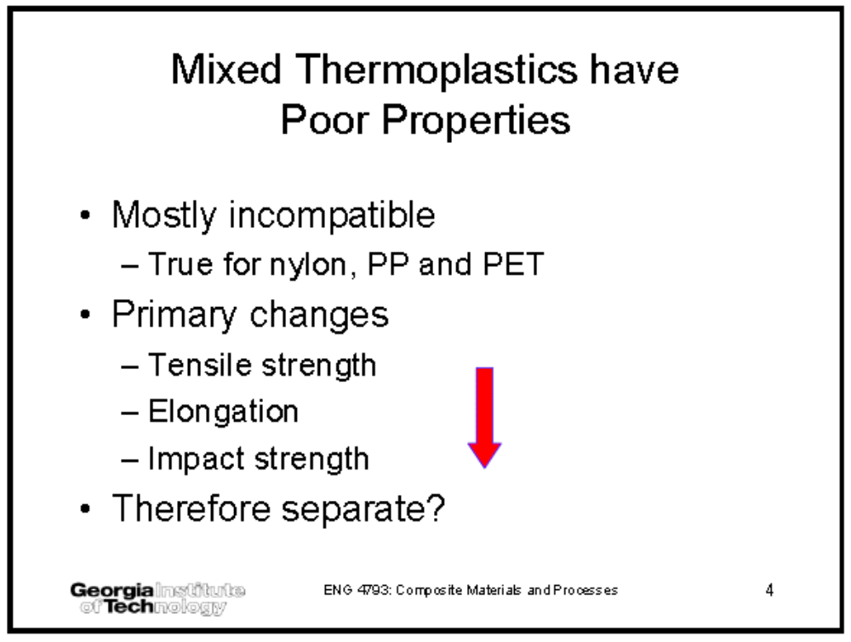
Recycling – [Callister Ch. 21]
Textile Fibers - Thermoplastics
Ref: http://www.ce.gatech.edu/

Slide 28
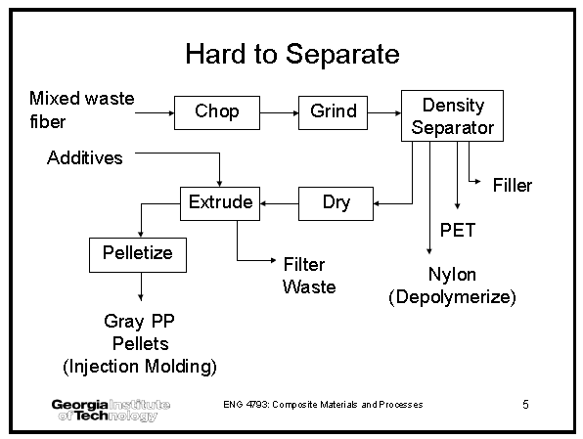
Recycling – [Callister Ch. 21]
Textile Fibers - Thermoplastics
Ref: http://www.ce.gatech.edu/

Slide 29
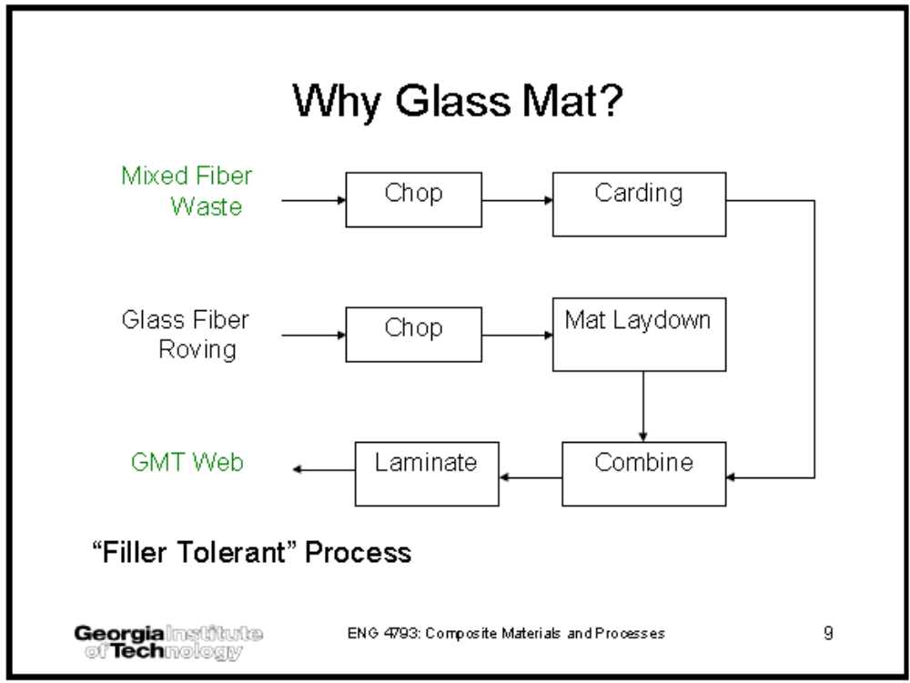
Recycling – [Callister Ch. 21]
Textile Fibers - Thermoplastics
Ref: http://www.ce.gatech.edu/

Slide 30
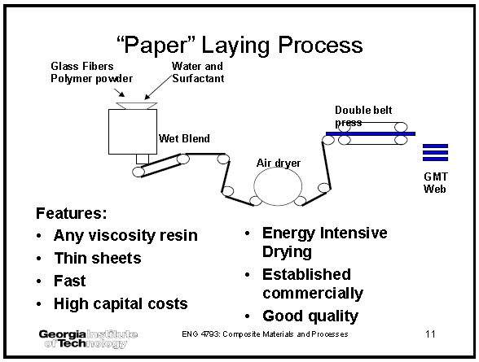
Recycling – [Callister Ch. 21]
Textile Fibers - Thermoplastics
Ref: http://www.ce.gatech.edu/

Slide 31
Recycling – [Callister Ch. 21]
Positive Developments in Plastics Recycling
Technical developments in identification, cleaning and sorting
Some availability of recycled-content grades, but mostly single feedstream or post industrial grades
Some, but limited, markets for recyclate, including high & low-end applications
  Qualification & use of recycled-content resins in high performance applications
OEM Design for Environment initiatives improving recycling prospects for newer products
Ref: http://www.iaer.org/communications/wsplasti.ppt

Slide 32
Recycling – [Callister Ch. 21]
Eco-Labels
Environmental Performance Certification for Products
Identifies products that meet specific environmental criteria
  This varies widely among labels
  Labels exist for electronics and many other products
A third-party identifies criteria and verifies adherence to criteria
Different from “green” symbol or claim made by manufacturers on product.
Ref: http://www.federalelectronicschallenge.net/tools/ecolabel.ppt

Slide 33










Recycling – [Callister Ch. 21]
Eco-Labels: Examples
EPEAT
TCO Development
Energy Star
Blue Angel
ITECO Declaration
B
B
Japan Eco Mark
Nordic Swan
Canada Environment Choice
European Union Eco-flower
Japan Green Purchasing Network

Slide 34
Green Technology
Materials
  … that can be produced with lower environmental impact
  … that can be easily recycled
Design
  Design components so that different materials can be easily separated
Processing
  Use production techniques that will have miminal effect on the environment
Recycling
  Establish a process to recycle or reuse
    Components
    Materials

Slide 35
Recycling – [Callister Ch. 21]
Summary
Recycling is important because….
  Economic aspects
    Supply of raw materials is limited
  Environmental
    Littering
    Solid waste
    Pollution cased by replacement production
Recycling needs to be encouraged ….
  Easy accessibility to recycling centers (curbside)
  Monetary encouragement
    Bottle tax
Green technology

Slide 36
Recycling
Resources used for today’s lecture
  Container Recycling Institute
    http://www.containerrecycling.org/
  ASM (American Society of Metals)
  ACerS (American Ceramics Society)
  ACS (American Chemical Society)
  ICMM (International Council on Mining and Metals)
    http://www.icmm.com//

Slide 37
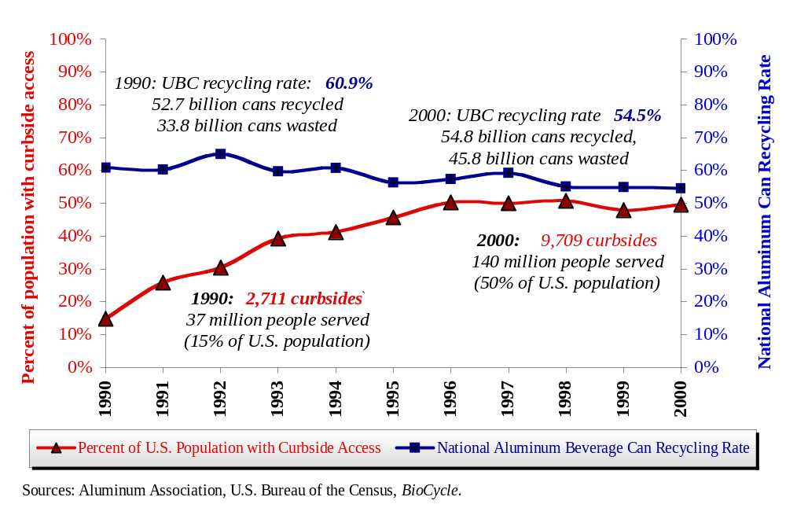
Recycling – [Callister Ch. 21]
Aluminum Can Recycling vs.
Access to Curbside Programs, 1990-2000
Ref: http://www.container-recycling.org/assets/ppt/GitlitzEPAOct29-02.ppt.

Slide 38
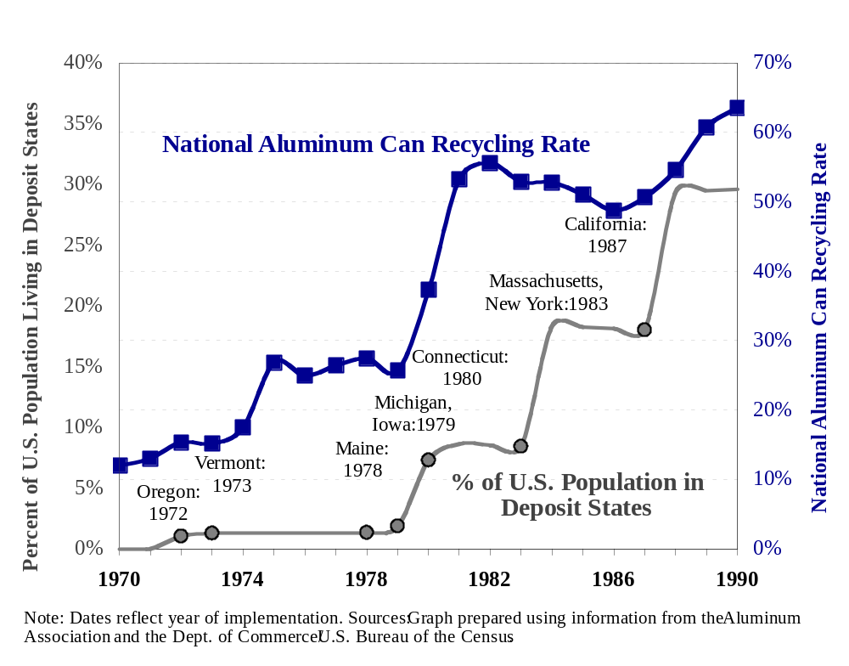
Recycling – [Callister Ch. 21]
The Effect of Deposit Laws
on the UBC Recycling Rate, 1970-1990
Ref: http://www.container-recycling.org/assets/ppt/GitlitzEPAOct29-02.ppt.

Slide 39
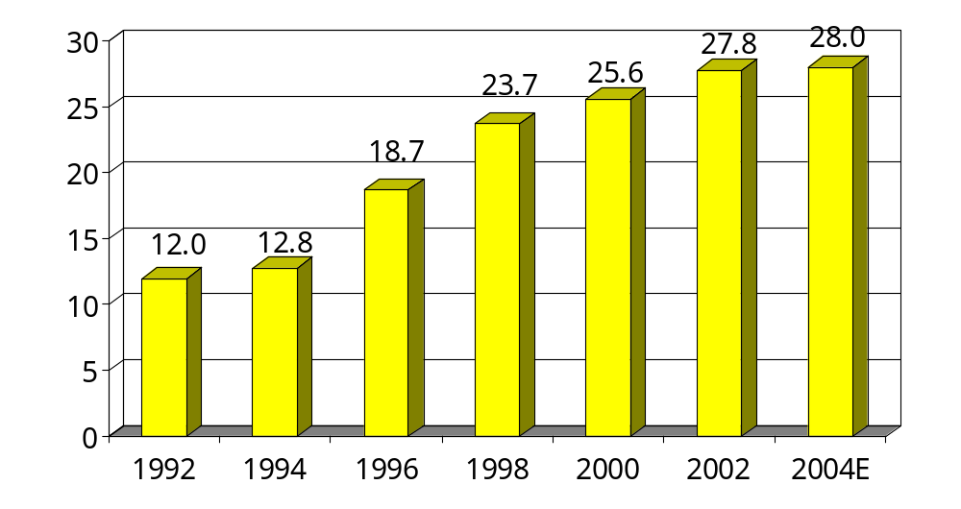
Recycling – [Callister Ch. 21]
PET Carbonated Soft Drink Bottle Sales: 1992 - 2004
Billions of Units
Source: American Plastics Council
Ref: http://www.container-recycling.org/ assets/ppt/1PlasticDebrisConference9.ppt

Slide 40
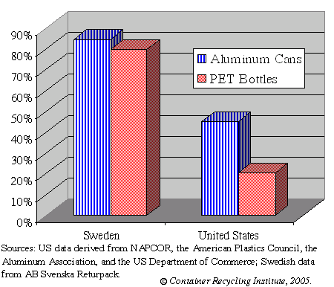
Recycling – [Callister Ch. 21]
Recycling Rates for PET Plastic and Aluminum
in Sweden and the U.S. (2004)

Slide 41
Recycling – [Callister Ch. 21]
Average Plastics Content of Electrical and Electronic Equipment (1995)
  Telecommunications 58%
  Small Appliances 35%
  Brown Goods 26%
  Large Appliances 21%
  Computers 16%
  Office Equipment 11%
  Medical Equipment 3%
Source: APME, 1998.
Ref: http://www.iaer.org/communications/wsplasti.ppt

Slide 42
Recycling – [Callister Ch. 21]
How are Eco-Labels Used
To aid in purchasing a product
Allow a purchaser to make an informed decision
Balancing of criteria done by experts
Eco-labels can be
  Specified in bid specification
    Must also use “or equivalent” language
  Used as a distinguisher between otherwise equivalent product
  As a differentiator when selecting what products to consider
Ref: http://www.federalelectronicschallenge.net/tools/ecolabel.ppt

Slide 43
Recycling – [Callister Ch. 21]
Types of Eco-Labels
Based on ISO Identification
Type I
  Voluntary, Multiple Criteria Based, that awards the use of a label on a product that indicates overall environmental preferability based on life-cycle
Type II
  Informative environmental self-declaration claims
Type III
  Voluntary program that provides quantified environmental data of a product set by a qualified third party, based on LCA and verified by a third party.
Ref: http://www.federalelectronicschallenge.net/tools/ecolabel.ppt

